Slide 1
Improving Search Engines Using Human Computation Games (CIKM09)
Date: 2011/3/28
Advisor: Dr. Koh. Jia-Ling
Speaker: Chiang, Guang-ting

Slide 2
Preview
Introduction
Page Hunt design
Experiment
Data analysis and discussion
Conclusions

Slide 3
Introduction
Web search engines have become an integral part of our everyday lives.
Evaluation methods are usually based on measuring the relevance of documents to queries.

Slide 4
Introduction
One is to use large hand-annotated evaluation.
Another is to use implicit measures of relevance. ex: clickthrough…..

Slide 5
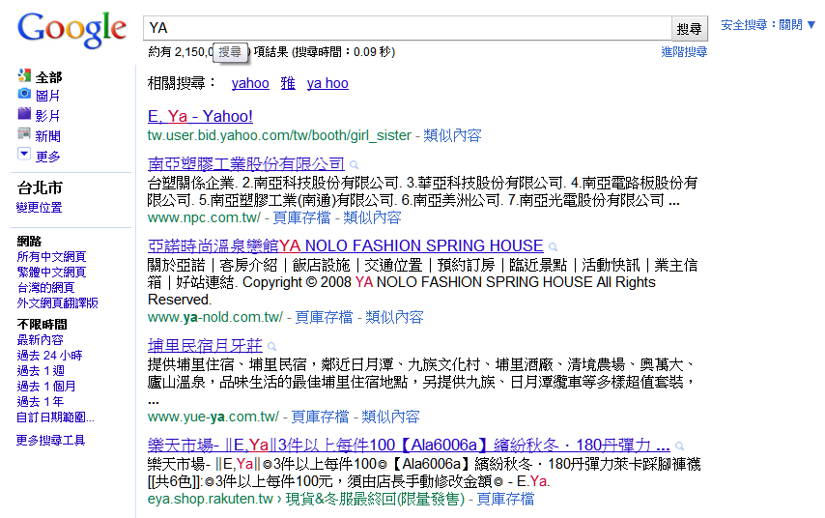
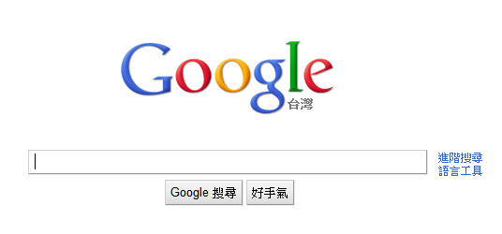
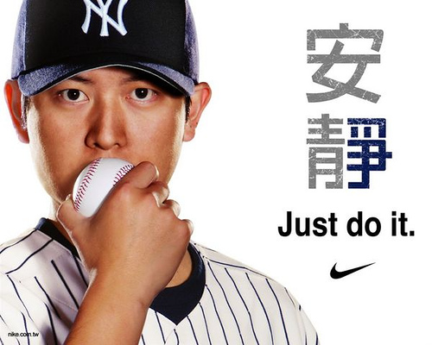
Introduction
DATA
王建民

Slide 6
Introduction
we seek to develop an efficient and effective human computation model for improving web search.
Page Hunt , a single-player game.

Slide 7
Page Hunt design
Consider about…..
Was the game fun??
Is the data we get from Page Hunt comparable to data we get from other sources?
Can we define a process that extracts useful information from the data?

Slide 8
Page Hunt design
1 : 100
2 : 90
3 : 80
…
it’s a LOOP
Match with top 5 result
Match with top 5 result
YES
YES
Match success-ful?
Player get random pages
The player view the page and types in a word as
query
Not in top 5 result
No
Depend by bitext matching. If change successful then get bonus.
Depend by bitext matching. If change successful then get bonus.
Edits/add query
……...
……...

Slide 9
Page Hunt design
Making Page Hunt fun
Timed Response
3 mins
Score Keeping and a Leader board
Frequent queries
Get bonus points if they avoid using these frequent terms.
Randomness
web pages
Bonuses (10%-double 5%-triple)

Slide 10
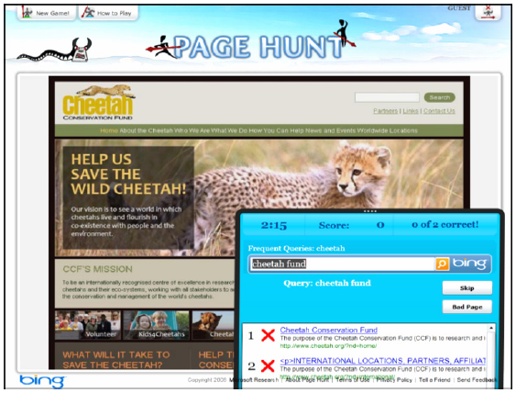

Slide 11
Page Race and Page Match
Page Race
A two-player competitive game, is a natural extension of Page Hunt.
Page Match
A collaborative game where two players are randomly paired up.

Slide 12
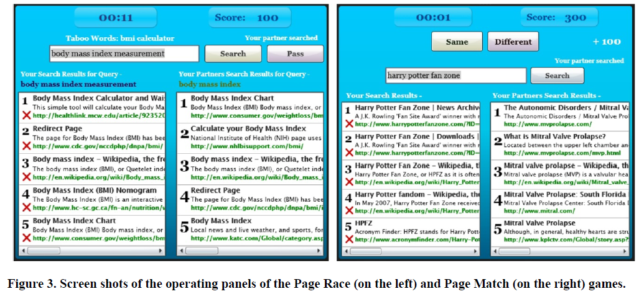

Slide 13
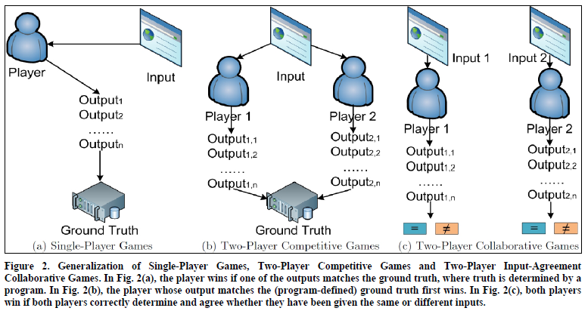
Page Hunt
Page Race
Page Match

Slide 14
Experiment
A period of ten days
10,000 people
Generating over 123,000 non-null labels on the 698 URLs in the system.
On average every player contributed over 12 labels, and every URL has over 170 labels.

Slide 15
Data analysis and discussion
Analysis about…..
Was the game fun??
Is the data we get from Page Hunt comparable to data we get from other sources?
Can we define a process that extracts useful information from the data?

Slide 16
Was the game fun ??
Players sent comments like
“addictive”
“I love the app. It has asticky, viral nature to it”
“Fun game!”
“…It’s a great game.Passing it along …”.
The players who were at the top of the leader board kept playing to keep their names on the leader board.
Judging from these numbers, and from the comments we got, this game seems to be fun.
How board u are!!

Slide 17
Is our data better than others??
Nature of queries elicited
URL Findability

Slide 18
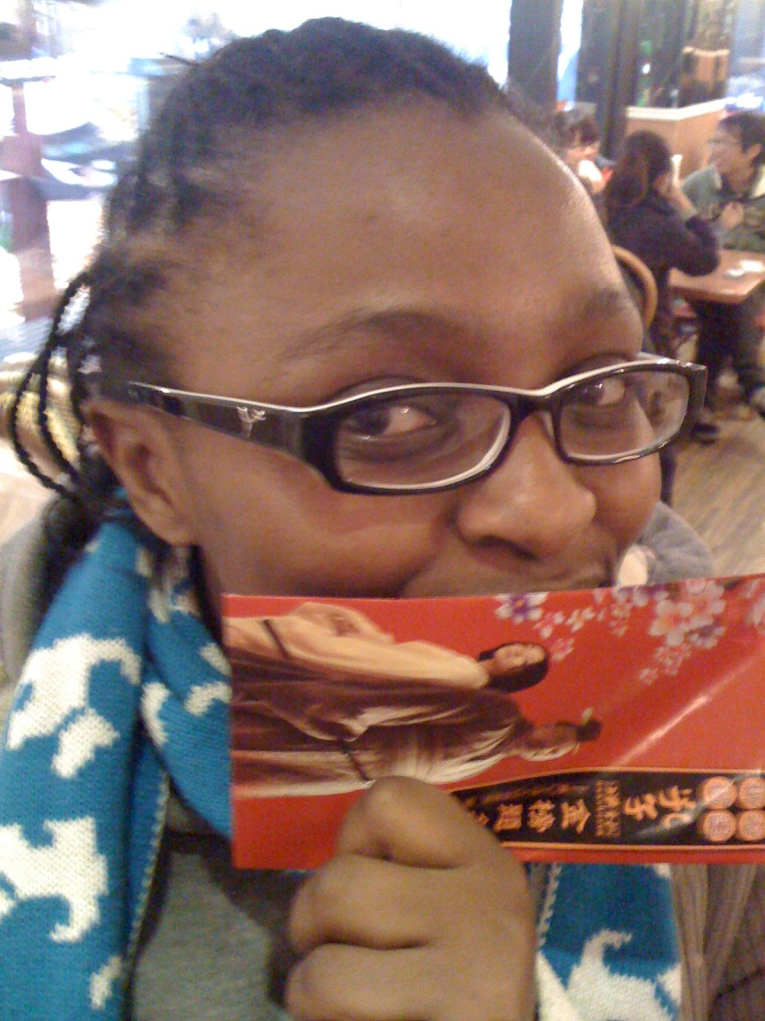
Nature of queries elicited
Shongwe Nonhlanhla
OK!
Shongwe Nonhlanhla super beauty
over-specified!
Shon、gwe、Nonh、lanhla
Under-specified!

Slide 19
Nature of queries elicited
Took a random sample of successful 100 <query, web page URL> pairs.
Two of writer analyzed these 100 pairs and categorized the queries as OK, Over-specified or Underspecified.
78% of the queries were OK, 15% were overspecified and 7% were under-specified.

Slide 20
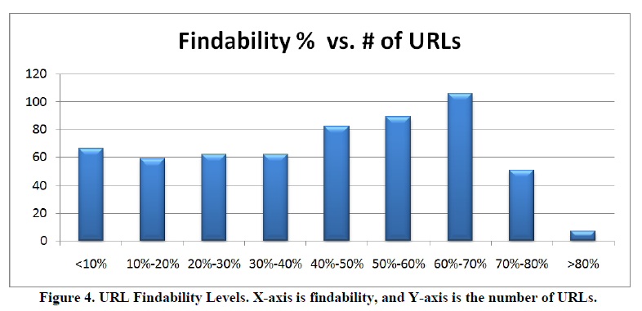
URL Findability
Findability Levels
10.0% of the 698 URLs have >70% findability 11.3% have <10% findability.

Slide 21
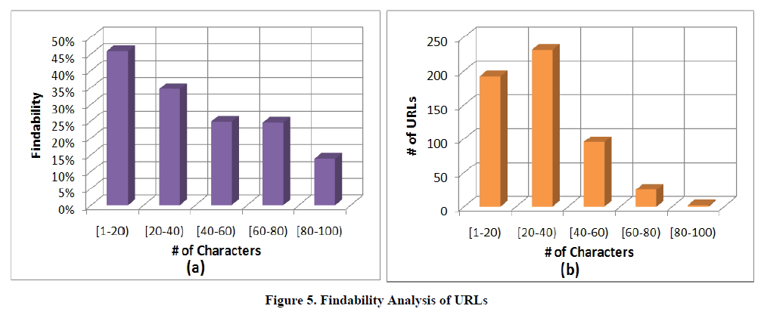
URL Findability
Findability as a Function of URL Length

Slide 22
What applications we gained from the data ??
Providing metadata for pages.
Providing query alterations for use in query refinement.
Identifying ranking issues.

Slide 23
Query Alterations from Game Data
Bitext Matching
Results from Bitext Matching
Query Alterations :
Altering the user’s query using other terms which may have been intended.

Slide 24
Bitext Matching
1.Most likely alignment | 2.Phrase pairs
 | Flip the assignment and train the models again. Bitext (A,B) Bitext (B,A)
Bitext (A,B)
Target side
B
P(0.5)
P(0.2)
P(0.1)
……
HMM Model
Source side
A
Trained hidden word alignment

Slide 25
Bitext Matching
Assume all the words are aligned expect for “state” ”of”
“new york department labor”
“new york state department of labor”
Extract the phrase pairs
Not be extracted because some words inside the phrase on one side are aligned to words outside the phrase on the other
side.
“ new york / new york state ”
“ department labor / department of labor ”
“ department / department of ”

Slide 26
Bitext Matching
We can write the probability of a target sequence and word alignment as:
s1 to sm be the source tokens
t1 to tn be the target tokens
a1 to an be the hidden alignment, where ai is a value ranging between 0 and m.

Slide 27
Results from Bitext Matching
Spelling or punctuation alterations:
JC Penny for JC Penney,or J C Penny.
Sitename to site alterations:
acid reflux and acidrefluxconnection.com
Acronym-Expansion alterations:
iht is the International Herald Tribune,
sls refers to the Society of Laproendoscopic Surgeons etc.
Conceptual alterations:
capital city airport is a valid alteration for Kentucky airport;
jlo is a valid alteration for Jennifer Lopez etc.

Slide 28
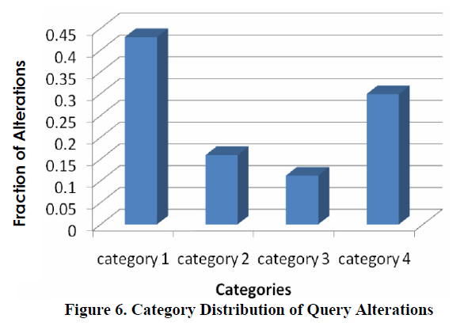
Results from Bitext Matching

Slide 29
CONCLUSIONS
CONCLUSIONS
Present a page-centric approach to improving Web search using human computation games.
the query data we obtain from the Page Hunt game is not very different from queries used on search engines.(good findaility)
a process to extract query alterations from game data, using the idea of bitext matching.

Slide 30
THANKS FOR YOUR LISTENING!

